Slide 1
Project: Spotify Data Analysis
Chelsea Sumba, Cindy Mateus Parra, & Alec Druggan

Slide 2
Questions:
Chelsea
Q1: What are the top 10 popular artists at the moment and is there a relationship on their popularity and the kind of genre of music they produce?
Q2: How do the energy levels of the 5 top songs compare to bottom 5 songs? Do energy levels contribute to the popularity of the songs?
Cindy
Q1: How does the energy of a track relate to its danceability for the top 10 genres?
Q2: Is there any connection between these audio features (speachiness and loudness) of a track and its popularity?
Alec
Q1: How long are the songs in this dataset, and what type of distribution describes their duration?
Q2: Do the lengths of songs correlate with their energy, valence, and danceability?

Slide 3
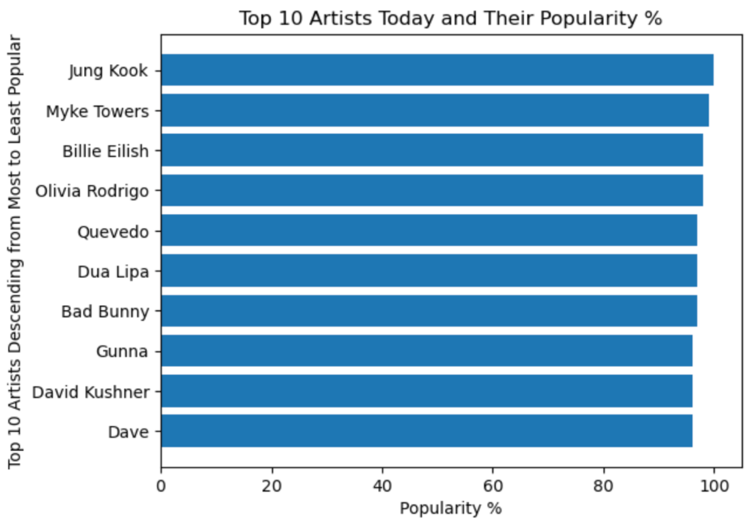
Chelsea Q1: What are the top 10 popular artists at the moment?

Slide 4
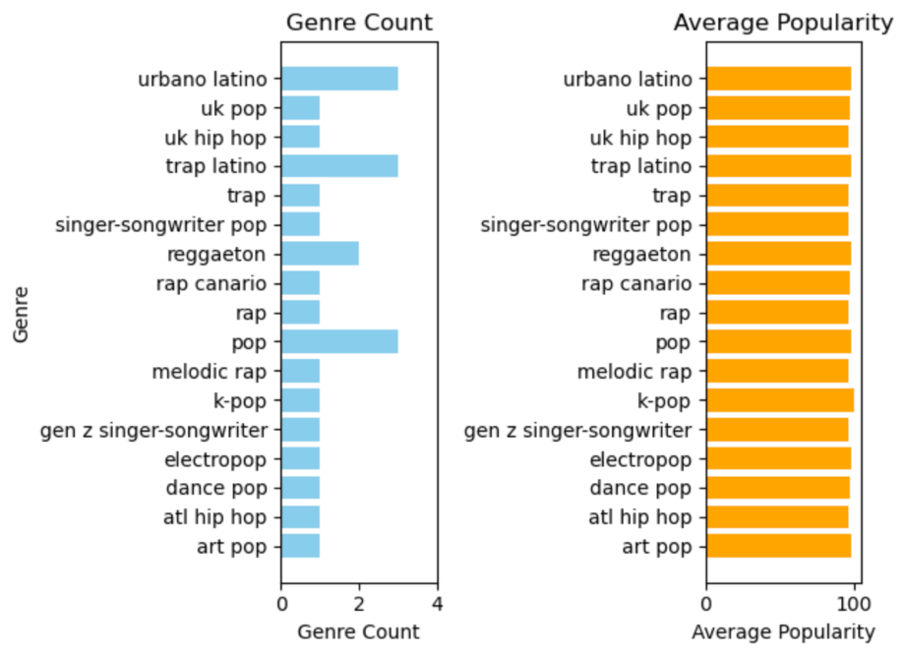
Popularity and the Kind of Genre of Music They Produce
K-pop reached 100% popularity at the moment with only 1 count of the K-pop genre (from the artist) compared to the rest of the genres.
Top 3 genres are k-pop, pop, and reggaeton/latin trap at this time.

Slide 5
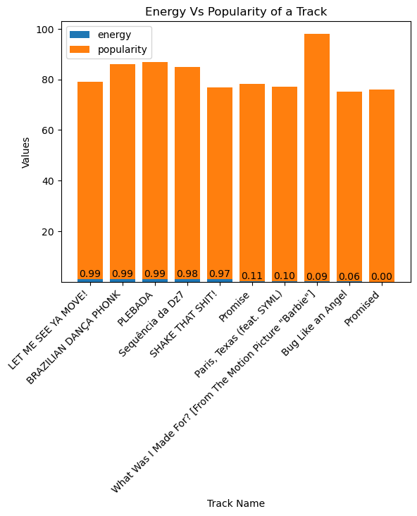
Chelsea Q2: How do the top 5 energy levels
compared to the top lowest energy levels and their popularity?
Billie Eilish single “What Was I Made For?” reached top popularity despite being one of the songs that has an energy level of 0.09 (low compared to high level of 0.99)
The most energetic songs do not reach Eillish’s popularity despite being most energetic
The track “Promised” has a popularity of 76% despite having an energy level of 0

Slide 6
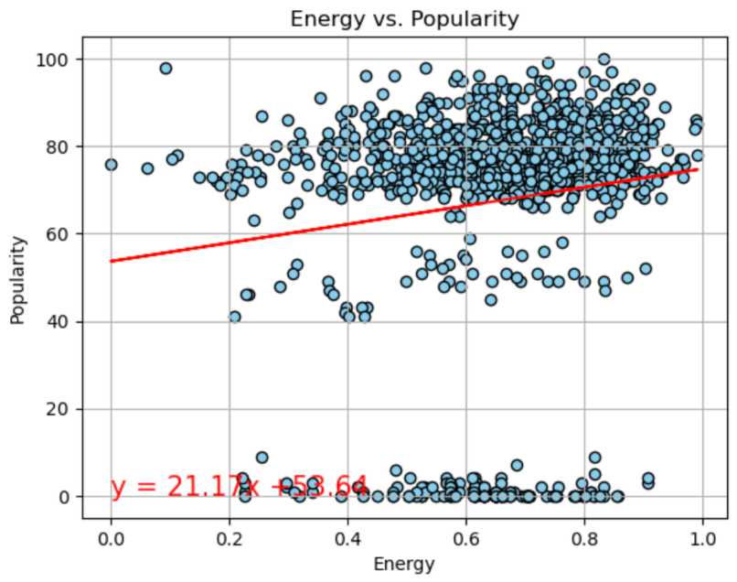
Do energy levels contribute to the popularity of the songs?
The r-value is: 0.13450391477380894
weak positive linear correlation
as energy increased, popularity also increases
y= 21.17x + 53.64

Slide 7
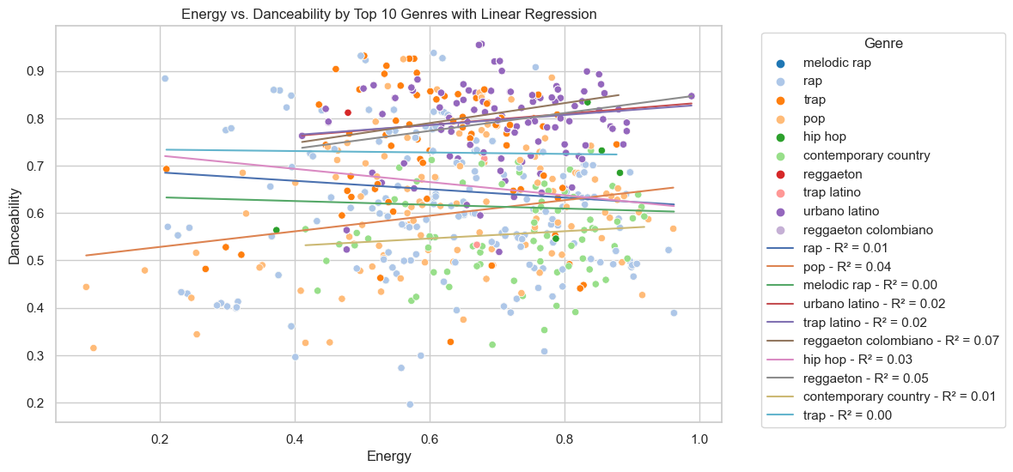
Cindy Q1:
How does the energy of a track relate to its danceability for the top 10 genres?

Slide 8
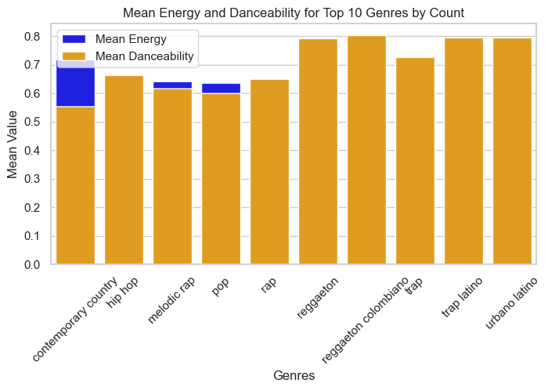
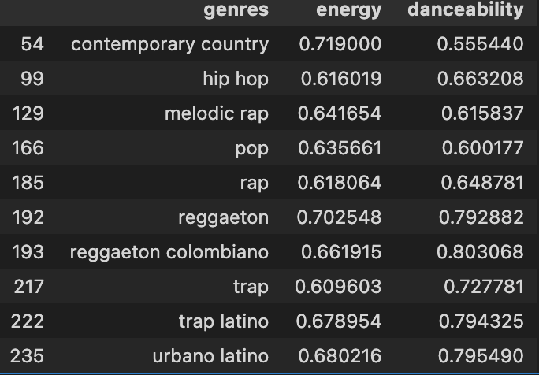
Cindy Q1:
How does the energy of a track relate to its danceability for the top 10 genres?

Slide 9
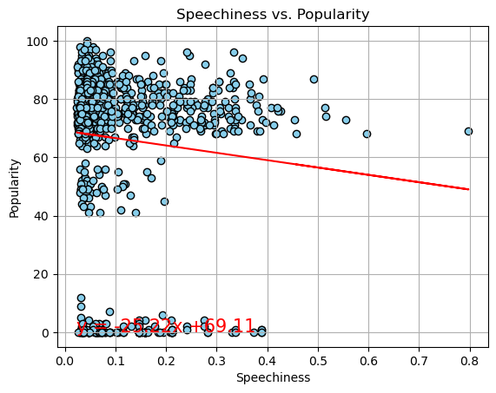
Cindy Q2:
Is there any connection between these audio features (speachiness and loudness) of a track and its popularity?
In this case r = -0.0894669444577
that suggest there is a weak negative linear correlation between the speachiness and popularity .
y = -25.22x + 69.11
The r-value is : -0.0894669444577

Slide 10
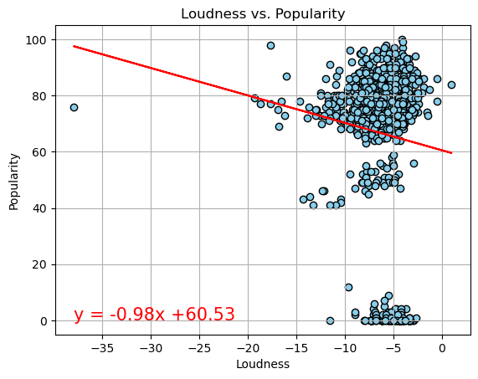
Is there any connection between these audio features (speachiness and loudness) of a track and its popularity?
The r-value is : -0.0915318154128
For this case r = -0.0091531854128 indicates a weak negative correlation
Between loudness of a track and its popularity
y = -0.98x + 60.53
The r-value is : -0.0915318154128

Slide 11
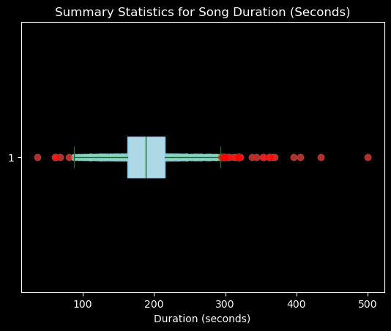
Alec Q1:
How long are the songs in this dataset, and what type of distribution describes their duration?
Summary Statistics:
count 1000.000000
mean 191.876534
std 46.962457
min 36.227000
25% 163.012750
50% 188.514500
75% 215.199000
max 500.117000
Total outliers: 32
Outliers below: 5
Outliers above: 27

Slide 12
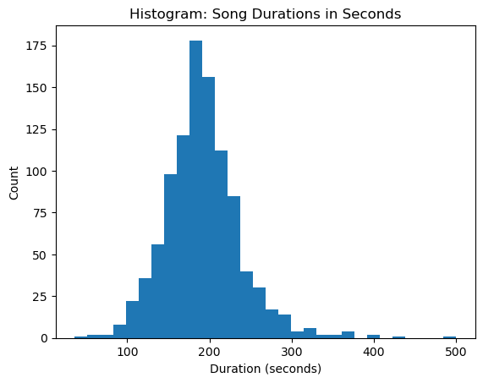
Distribution:
Histogram showcasing the duration.
Visually showcases a normal distribution.

Slide 13
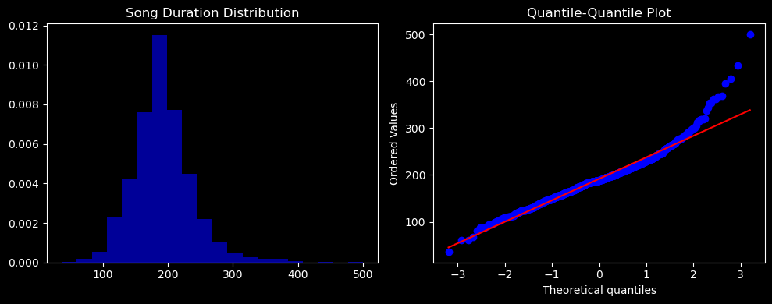
Quantile-Quantile Plot Shows non outlier values have linear relationship, showing normal distribution.

Slide 14
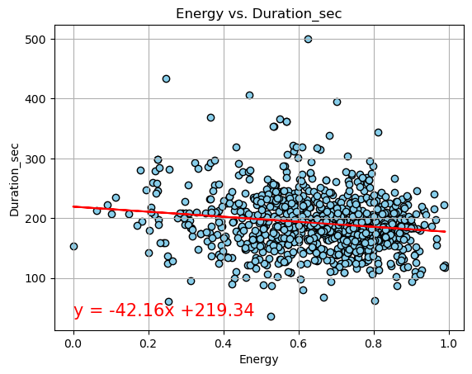
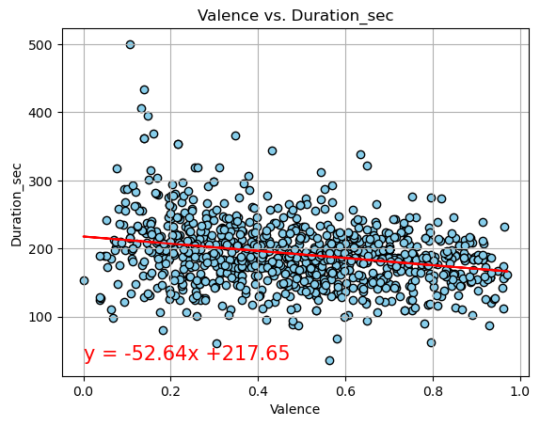
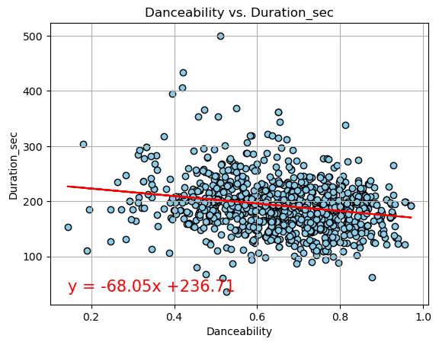
Alec Q2:
Do the lengths of songs correlate with their energy, valence, and danceability?

Slide 15
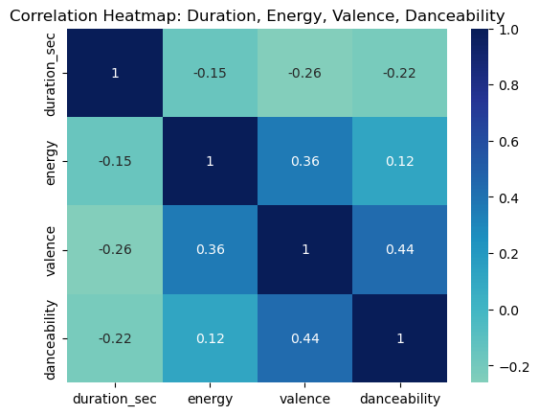
Correlation map:
Correlation between Song Length and Energy: This correlation coefficient of approximately -0.1541 indicates a weak negative correlation between song length and energy. As song length increases, the energy tends to decrease slightly. The negative sign suggests that longer songs tend to have slightly lower energy levels.
Correlation between Song Length and Valence: This correlation coefficient of approximately -0.2607 indicates a slightly stronger negative correlation between song length and valence. As song length increases, the valence (positivity) of the songs tends to decrease to some extent. The negative value suggests that longer songs might be associated with slightly less positive valence.
Correlation between Song Length and Danceability: This correlation coefficient of approximately -0.2176 indicates a moderate negative correlation between song length and danceability. As song length increases, the danceability tends to decrease moderately. The negative value suggests that longer songs are associated with reduced danceability.
Additional information we can garner from the heat map is that danceability and valence have a moderately strong positive correlation, while valence and energy have a moderate positive correlation.

